Slide 1

Car Market Trends Analysis with Car Dekho Data -
VENKATA SATYA SRIKAR PARVATHA

Slide 2

PROBLEM STATEMENT
Analyze the Car Dekho dataset to identify key trends and insights in the car market. The analysis should focus on understanding the factors influencing car prices, identifying popular car features, and examining market dynamics over time.
This information will help stakeholders, including buyers, sellers, and manufacturers, make informed decisions. Key tasks include data cleaning, exploratory data analysis (EDA), data visualization, and deriving actionable insights from the data.

Slide 3
Project Description
The automotive industry is rapidly evolving, influenced by shifting consumer preferences, technological advancements, and economic factors. This project focuses on analyzing the Car Dekho dataset, which encompasses detailed information about various car models, their specifications, prices, and other relevant attributes. By examining this dataset, we aim to extract meaningful insights that can help stakeholders, including manufacturers, dealers, and consumers, understand the current trends and dynamics in the car market.
The analysis begins with data cleaning and preprocessing to ensure the dataset is accurate and consistent. This involves handling missing values, correcting data types, and removing any duplicates. Following this, exploratory data analysis (EDA) will be conducted to uncover patterns and relationships within the data. Key features such as brand, year, mileage, and fuel type will be examined to determine their impact on car prices. Additionally, the project will analyze market trends over time, identifying popular car models and features, and studying depreciation trends to understand how car values change with age and usage.
The insights derived from this analysis will be presented using various visualization techniques, making it easier to communicate the findings effectively. The final outcome of this project will include actionable recommendations for stakeholders, such as identifying the best time to buy or sell a car, understanding which features add the most value, and anticipating future market trends. These insights will enable better decision-making, ultimately benefiting all parties involved in the automotive industry.

Slide 4

Objectives
The primary objectives of this project are:
Data Cleaning and Preprocessing: Ensure the dataset is clean and consistent by handling missing values, correcting data types, and removing duplicates.
Exploratory Data Analysis (EDA): Conduct thorough EDA to understand the distribution of variables, identify patterns, and uncover initial insights.
Feature Analysis: Examine the relationship between car prices and various features such as brand, year, mileage, fuel type, and more. Determine which features have the most significant impact on car prices.
Market Trends and Dynamics: Analyze trends over time to understand how the popularity of different car models and features has evolved. Identify the most and least popular car features.
Depreciation Analysis: Investigate how car values depreciate over time, considering factors like age, mileage, and condition.
Data Visualization: Use matplotlib and other visualization tools to create clear and informative visual representations of the data, highlighting key insights.
Conclusions and Recommendations: Summarize the findings from the analysis and provide actionable insights for various stakeholders, including car buyers, sellers, and manufacturers.

Slide 5
Methodology
Data Cleaning: Handle missing values, correct data types, and remove duplicates.
Exploratory Data Analysis: Use pandas and numpy for data manipulation and summary statistics. Utilize matplotlib for visualizations.
Feature Engineering: Create new features that might be useful for analysis or predictive modeling.
Visualization: Develop various plots (scatter plots, bar charts, histograms, etc.) to visualize data distributions and relationships.
Analysis and Insights: Conduct in-depth analysis to understand the factors affecting car prices and market trends.

Slide 6
WHO ARE THE END USERS?
Car Buyers: Individuals looking to purchase a car can use the insights to make informed decisions about which models offer the best value, understand depreciation trends, and identify the most desirable features.
Car Sellers and Dealers: Dealerships and individual sellers can leverage the analysis to price their vehicles competitively, understand market demand, and identify which features and models are most popular among buyers.
Car Manufacturers: Manufacturers can use the data to gain insights into consumer preferences, identify trends in the market, and make strategic decisions regarding production and marketing.
Market Analysts and Researchers: Analysts and researchers studying the automotive market can use the findings to understand broader trends, forecast future developments, and provide advice to stakeholders in the industry.
Financial Institutions: Banks and lending institutions can benefit from understanding car depreciation trends and market values, aiding in the valuation of car loans and leases.
Policy Makers: Government agencies and policy makers can use the insights to inform decisions related to transportation policies, environmental regulations, and economic planning.

Slide 7

Technology Used
Python: The primary programming language used for data analysis and manipulation.
Pandas: A powerful data manipulation and analysis library in Python used for data cleaning, preprocessing, and exploratory data analysis (EDA).
NumPy: A library for numerical operations in Python, providing support for arrays, matrices, and a collection of mathematical functions.
Matplotlib: A plotting library in Python used for creating static, interactive, and animated visualizations to represent the data insights.
Jupyter Notebook: An open-source web application that allows the creation and sharing of documents containing live code, equations, visualizations, and narrative text.
Seaborn: A Python visualization library based on matplotlib that provides a high-level interface for drawing attractive and informative statistical graphics.
Scikit-learn: A machine learning library in Python used for implementing machine learning algorithms, which may be utilized for advanced analysis such as predictive modeling.
Google Colab: A cloud service that supports Jupyter notebooks and provides free access to computational resources, often used for coding and running Python notebooks.

Slide 8
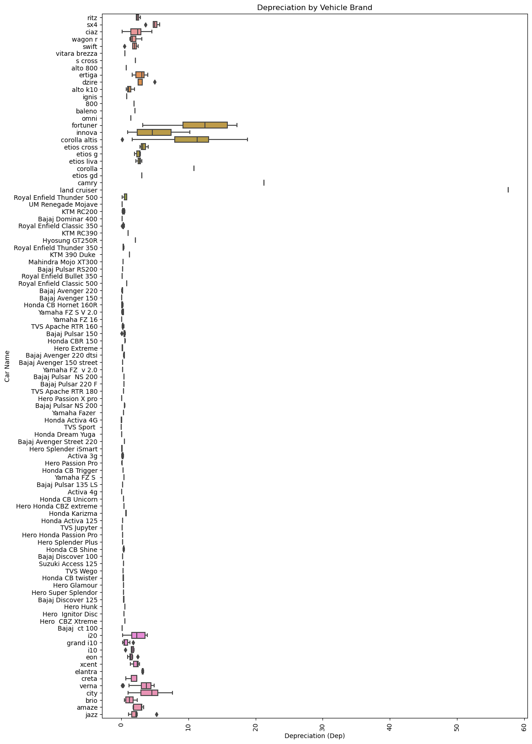
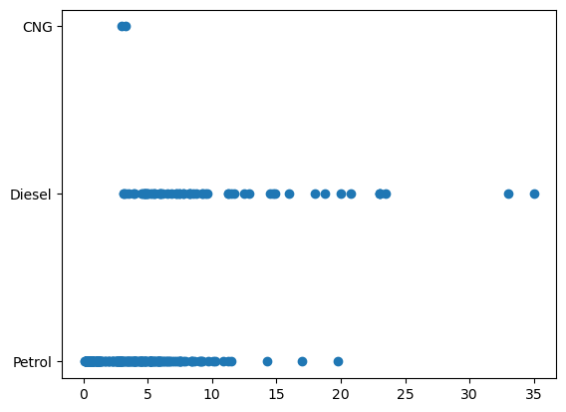
EDA RESULTS

Slide 9
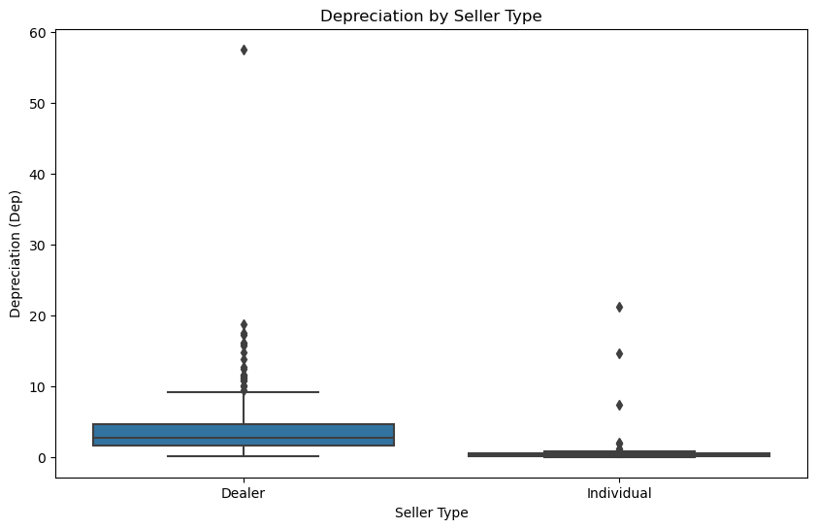
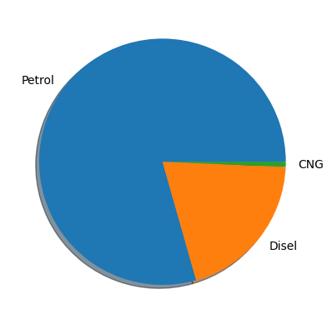
EDA RESULTS

Slide 10
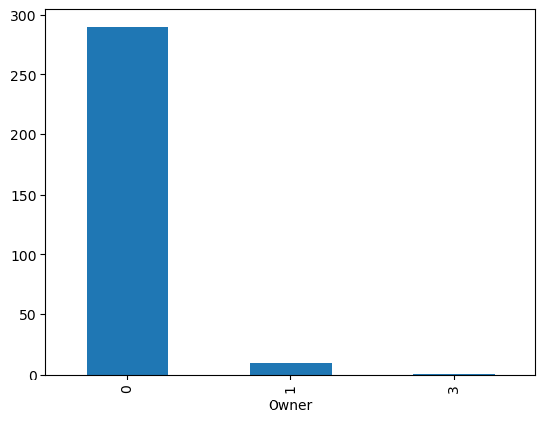
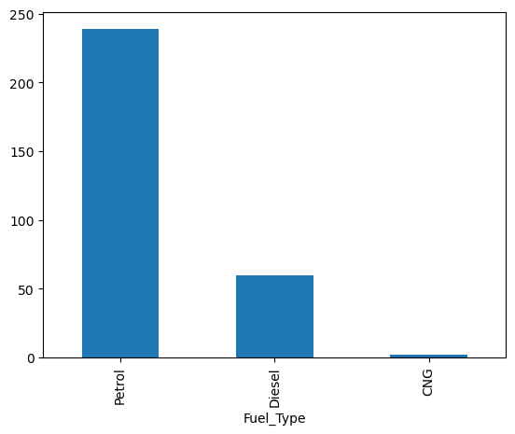
EDA RESULTS

Slide 11
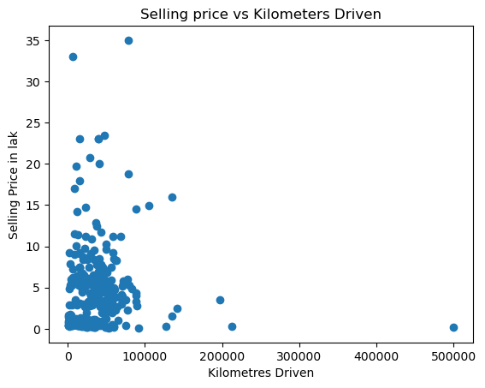
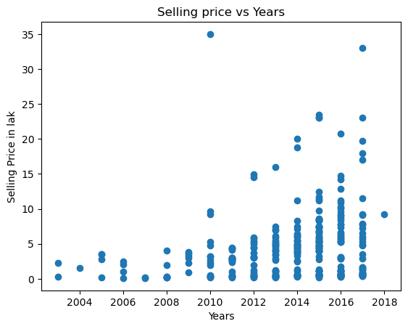
EDA RESULTS

Slide 12
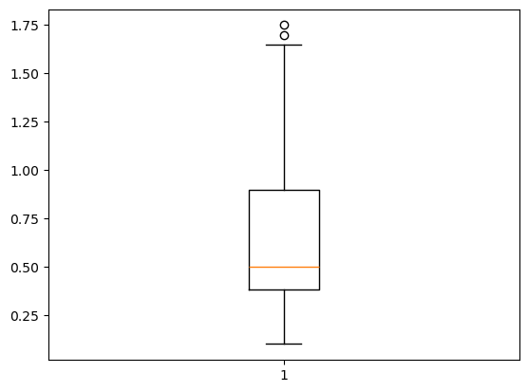
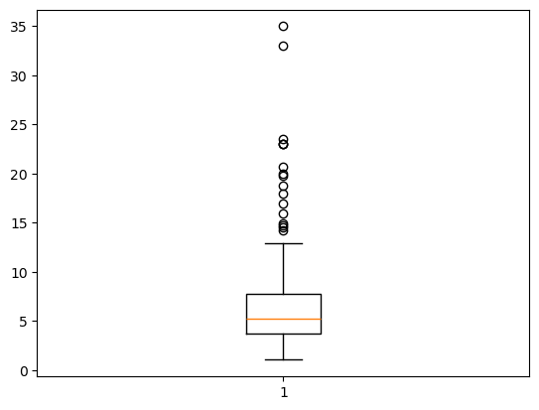
EDA RESULTS

Slide 13
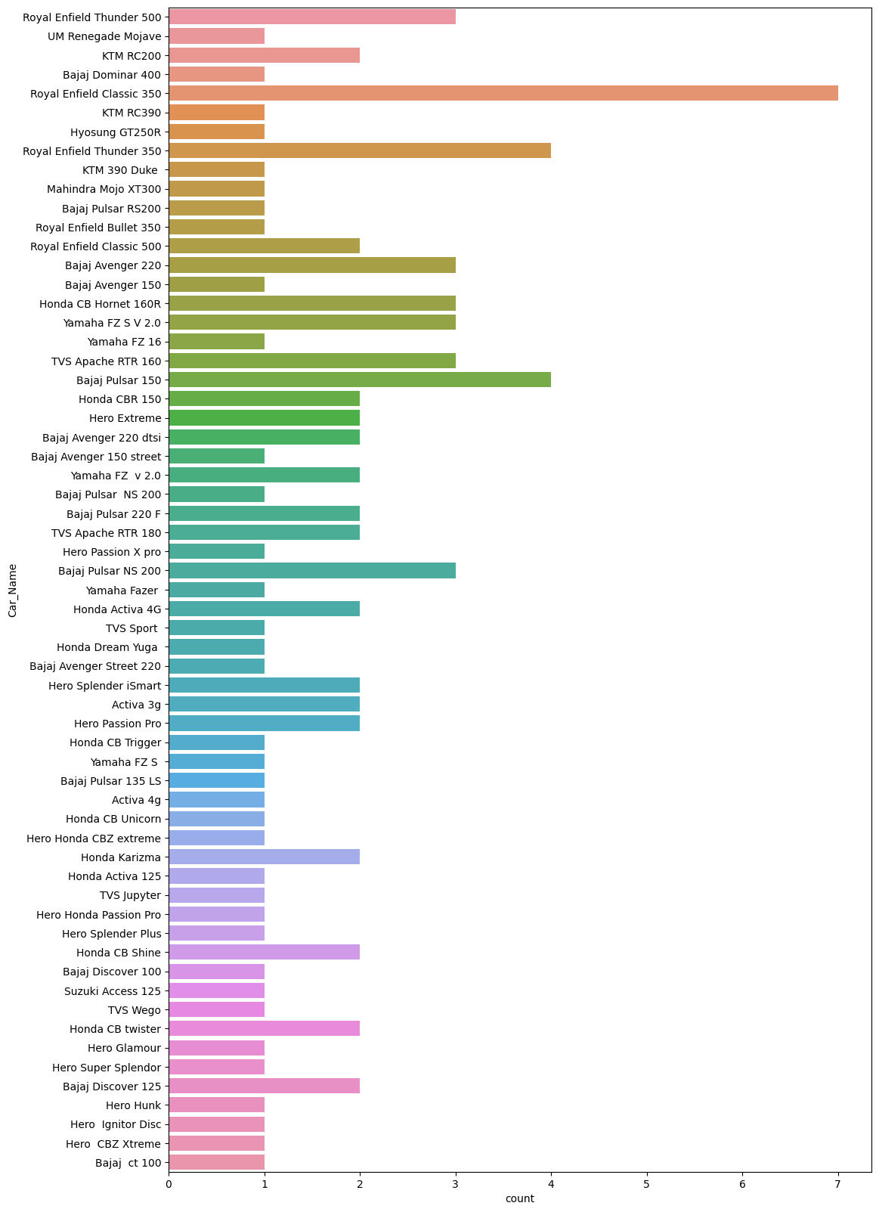
EDA RESULTS

Slide 14
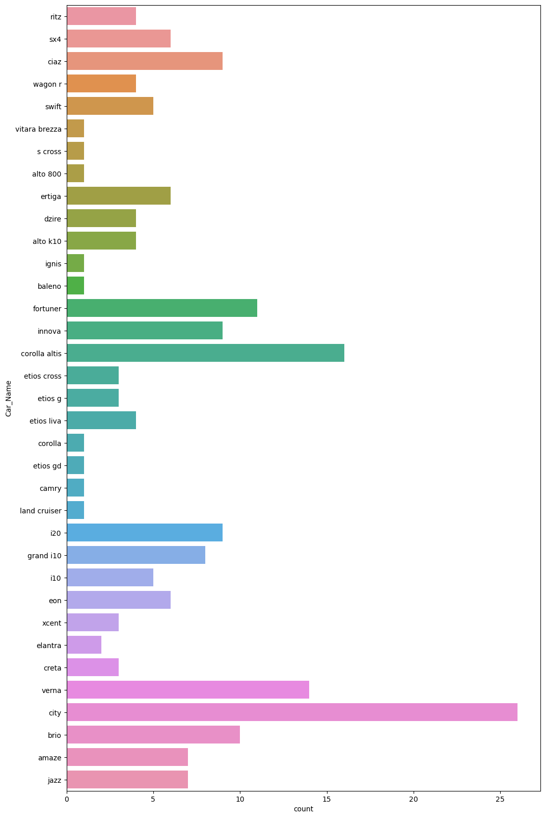
EDA RESULTS

Slide 15
Code Execution & Data Sets
Git Hub –
VenkataSatyaSrikarParvatha/VOIS (github.com)
Visit the link by – ctrl + click
It contains a reference data set taken from car deko
A Jupyter Notebook Executed python code for the reference of execution
.
.

Slide 16
References
Medium - Data Analysis on vehicle Dataset from Car-Dekho using Python Libraries.
Data Analysis on vehicle Dataset from Car-Dekho using Python Libraries. | by Vikrant Balwant Nikumbhe | Geek Culture | Medium
Vehicle dataset from cardekho – Kaggle Data Set.
Vehicle dataset from cardekho (kaggle.com)
.
.

Slide 17
Conclusion
This project will provide a detailed analysis of the Car Dekho dataset, offering valuable insights into the car market. By understanding the factors that influence car prices and identifying market trends, stakeholders can make more informed decisions, leading to better outcomes in the automotive industry.
.
.

Slide 18
Thank you
.
.

